Slide 1
SQUADRAMA EXTRA DOCS
This doc will contain some updated flowchart and the shifting of project ahead in future or near future.
Flowchart
Updated tech stack
Future updates/ Feature addition/ Future scope.

Slide 2
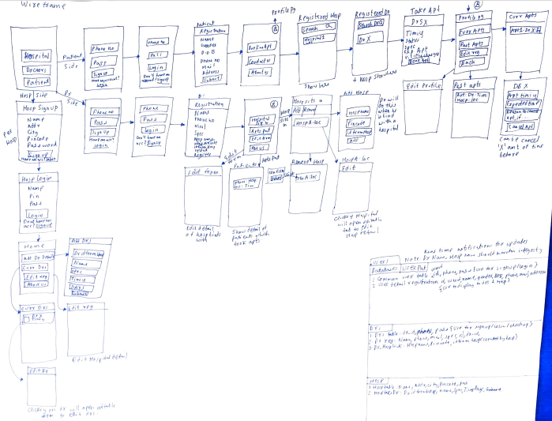
Wireframe of our solution

Slide 3
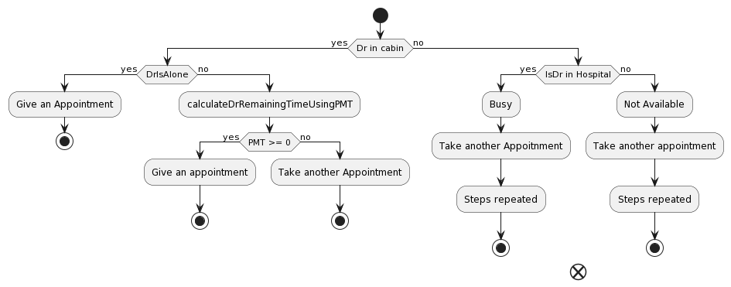
Overview of scheduling an appoint.

Slide 4
We will be updating tech stack after the first version or when user increases rapidly to:
Database: NoSQL (Document based)
If any other needed we will be using it to improve speed and performance.

Slide 5
Future scope & Business model. (Later Stages)
Providing medicines via app through delivery. This will help other user which may want medicine on door step and it will help in generating revenue for app.
Option of payment through app (Payment such as visiting charges, medicine payment, etc).
Uploading documents such as prescription or reports (X-rays, CT scan, Ultrasound etc)
Providing a chat room to connect with doctor with rules and regulations.

Slide 6
Extra future features.
Using ML/DL to read the prescription and purchase medicine if user give it.
Making report explain via AI if needed.
Providing AI bots assistant for doctors to reduce overheads.
Using AI for guidance to hospital (Providing map path feature).
High level cryptography system to make it very very secure.

